Slide 1

DO YOU BELIEVE IN
DATA ANALYTICS?
The Story of the 2019
GWU Data Analytics Bootcamp and
Their Attempt to Understand Hockey
By: The Goalie Gurus
Brett Schneider, Will Seymour,
Zachary Spahr, Nedal Swehli, John van Zalk

Slide 2
Motivation and Summary
Hockey is a complex sport
The outcome of each game is hard to predict statistically
We sought to use our newfound skills as data analysts to predict game outcomes
Notes:
Guideline:
Define the core message or hypothesis of your project.
Describe the questions you asked, and why you asked them
Describe whether you were able to answer these questions to your satisfaction, and briefly summarize your findings

Slide 3
Research Proposal
Project Purpose: utilize NHL APIs and other data sources to gather stat data to determine what factors minimize the number of goals scored against a team
Hypothesis: goals against is correlated with number of shots against, possession, high danger chances, penalty time (for and against), number of blocked shots, and avg shot distance.
Data sources:
1. Hockey Reference (https://www.hockey-reference.com/)
2. API (https://github.com/dword4/nhlapi)
3. API (https://www.mysportsfeeds.com/)
4. Hockey Reference: (https://www.hockey-reference.com)
Notes:
Guideline:
Define the core message or hypothesis of your project.
Describe the questions you asked, and why you asked them
Describe whether you were able to answer these questions to your satisfaction, and briefly summarize your findings

Slide 4
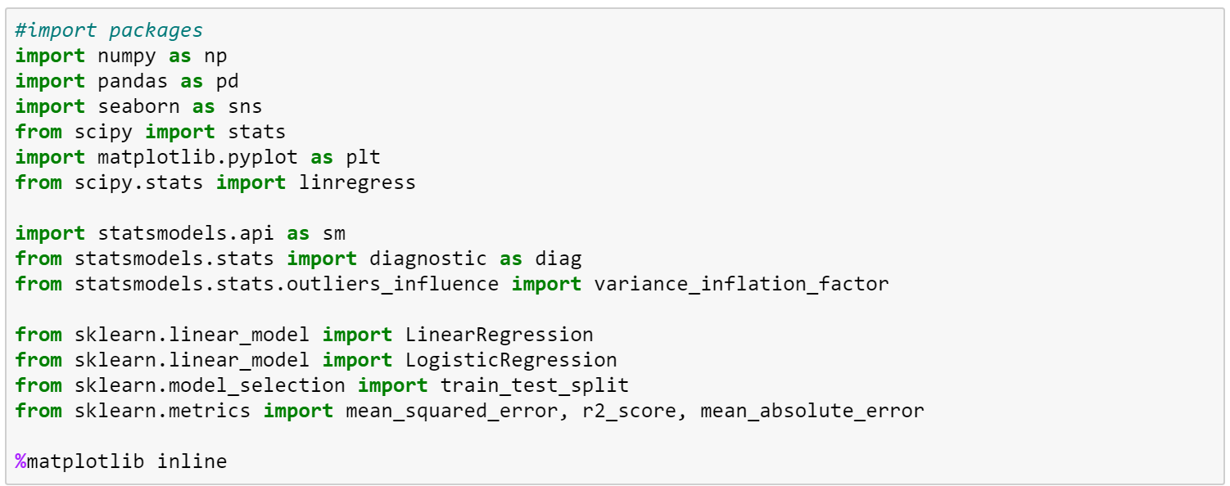
Libraries Used

Slide 5
QUESTION #1

Slide 6
Questions and Data
We started with the question “which stats correlate with good defense”
We defined good defense as giving up the least amount of goals against.
We started by connecting to the MySportsFeed API and pulling every game for 5 seasons, so about 10,000 games.
Then we grouped the data by team and did our analysis..
Notes:
Guideline:
laborate on the questions you asked, describing what kinds of data you needed to answer them, and where you found it

Slide 7
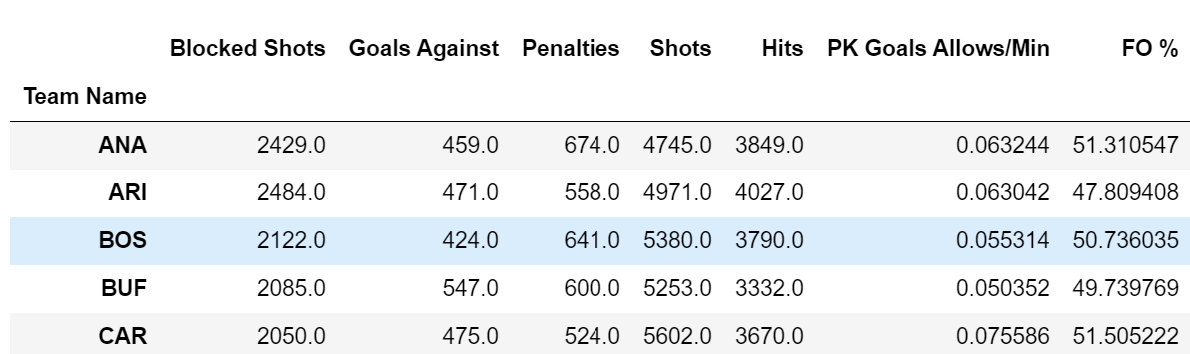
Data Set - Stats by Team

Slide 8
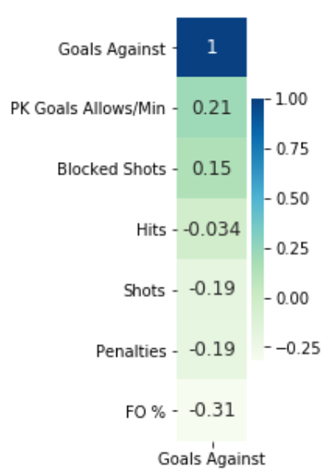
Correlation to Goals Against

Slide 9
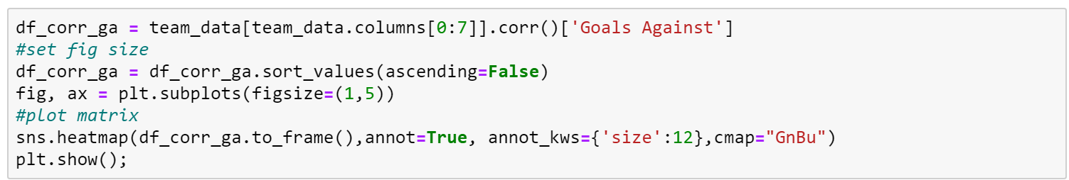
The Code

Slide 10
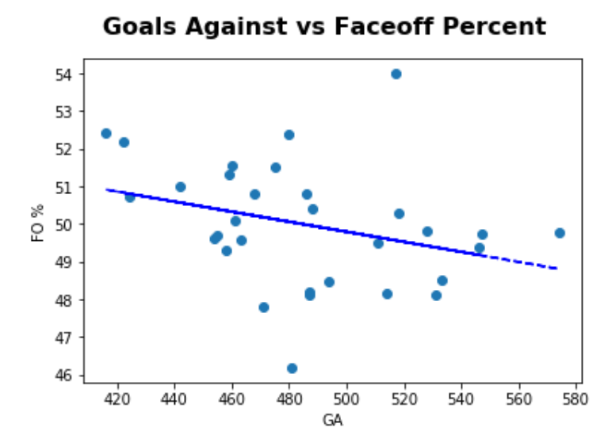
Regressing FO% against GA

Slide 11
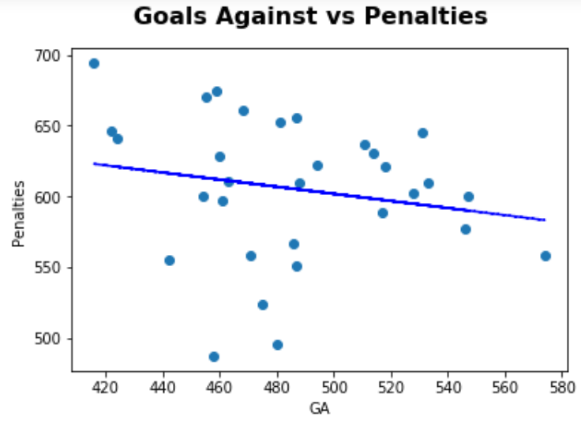
Regressing Penalties against GA

Slide 12
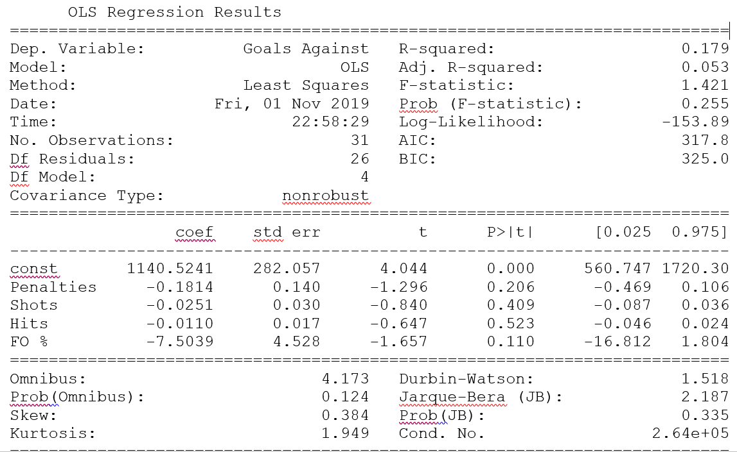
Regression Results

Slide 13
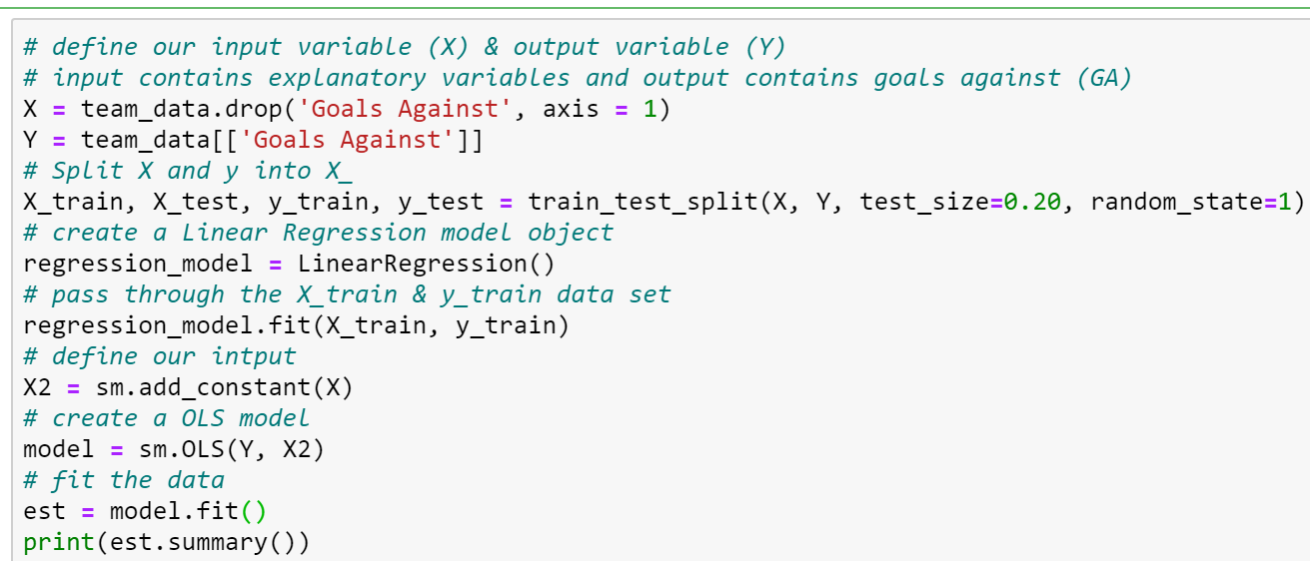
The Code

Slide 14
Findings
No significant relationships
Very very low R-Squared

Slide 15
STOP!
TWITTER TIME

Slide 16
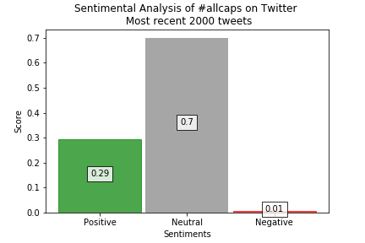
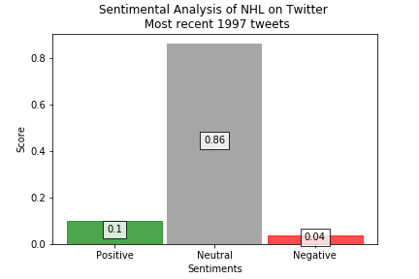
VADER Sentiment Analysis

Slide 17
BACK TO YOUR REGULAR SCHEDULED PROGRAMMING
QUESTION #2

Slide 18
Questions and Data
Once we saw that we had every game by wins and losses, we decided to do some analysis to see what leads to victories...besides scoring more goals than the other team
We pulled the data from Hockey Reference manually. This included 3 seasons worth of data and a lot more stats.
Then we put it in a dataframe, cleaned it, grouped it by wins and losses, and did our analysis

Slide 19
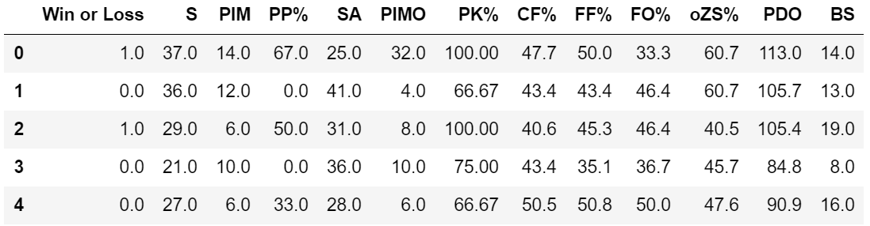
Data Set - Game Logs

Slide 20
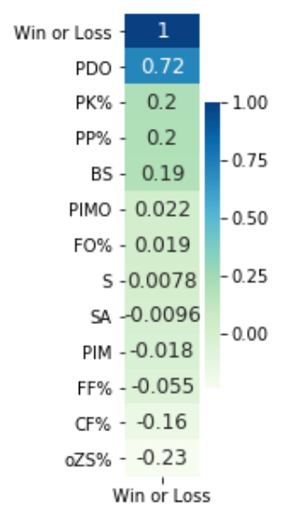
Correlation to Wins

Slide 21
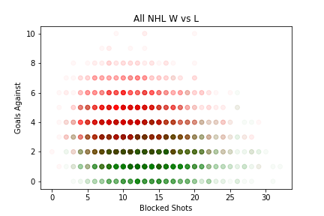
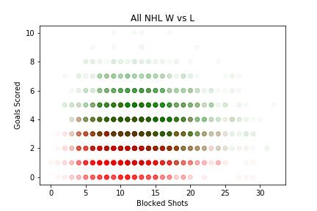
Do Blocked Shots Matter?
Notes:
Since we were mostly interested in defense we wanted to look at how a defensive stat like blocked shots is related to goals and winning vs losing. In these scatter plots blocked shots is on the x-axis, goals either scored or allowed are on the y axis and the dots are color coded according to the outcome of the game (green = win, red = loss). The more ‘solid’ a dot’s color the more games had similar stats. Based on these plots, blocked shots do not seem to matter much in the outcome of the game compared to goals.

Slide 22
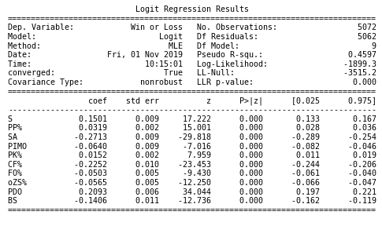
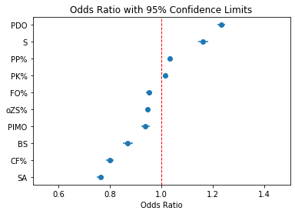
Multi Logistic Regression

Slide 23
Findings
We found several significant relationships with game outcomes. All relationships are relatively weak (coefficients less than 0.3). We have a small R2 (our model predicts only 46% of variability).
Specific finding with explanatory variables:
Shots for/against (on goal) are the most import factors in determining the outcome of a game.
An increase in power play minutes doesn't make a team more likely to win a game, but having a strong power play and penalty kill unit does.
Blocking more shots makes a team more likely to lose because they are sustaining more shots.
Faceoff percentage and percentage of faceoffs in offensive zone (oZS%) do not make a team more likely to win.
OR = 1 means there's an equal probability of an outcome occurring

Slide 24
SUPPLEMENTAL ANALYSIS:
Goal Scoring and Winning Probability

Slide 25
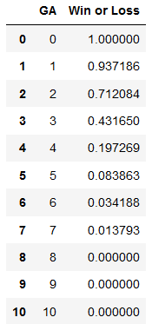
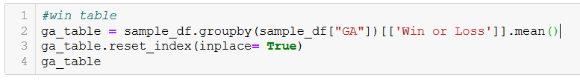
Approach and Code Sample:
We sought to visualize how scoring and allowing goals impacts the probability of winning a game.
Notes:
Since Win is dichotomous (1 or 0) we can group by the number of goals and take the mean to calculate the probability of winning for each goal scored.

Slide 26
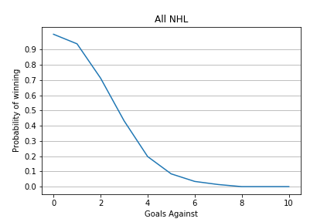
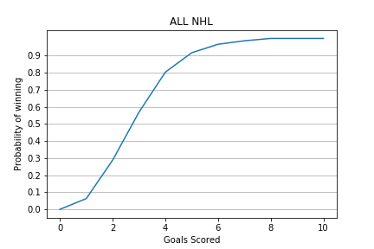
Winning Probability and Goals
Notes:
These are mirror images of each other, because each game is in the data set twice, once for each team. So let’s look at a few individual teams

Slide 27
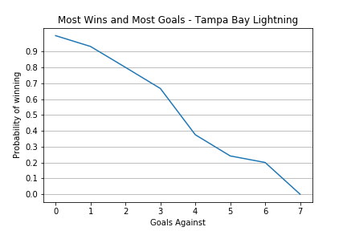
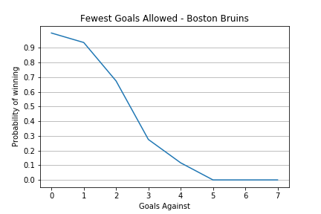
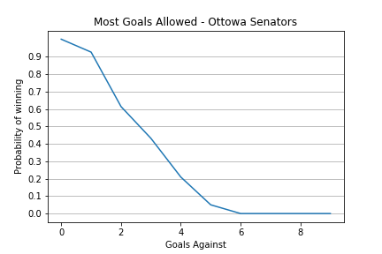
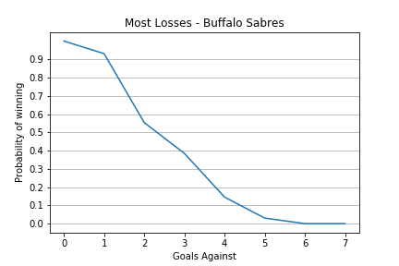
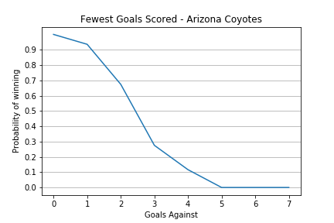
Note the changes in slopes - Tampa Bay can allow 6 goals in a game and still have a 20% chance of winning. The other teams have 0% chance of winning after giving up that many goals
Notes:
Goals against

Slide 28
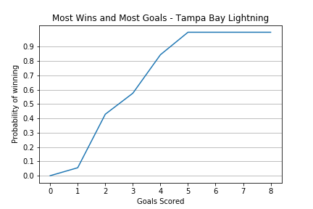
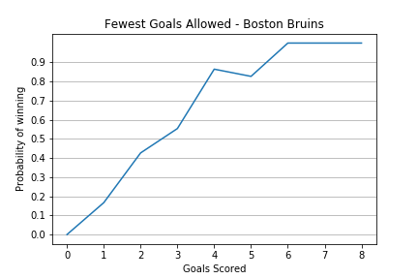
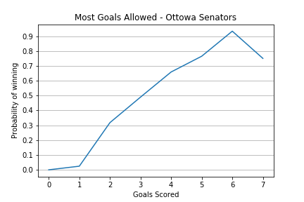
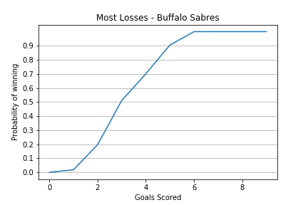
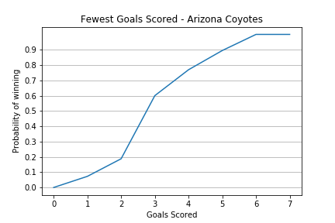
Notes:
Goals scored - These seem pretty similar especially comparing most wins/goals to most losses. Allowing more goals and not scoring enough goals looks to impact win probability the most (see OTT and ARI)

Slide 29
HELPFUL CODE

Slide 30
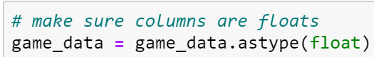
Helpful Code

Slide 31
QUESTIONS?

